Slide 1
Image Filtering
Running Max/min Filters
The running Max and min filters are the two extremes of the rank-order filters.
They are very effective in removing pepper noise and salt noise, respectively, from an image, but perform very poorly in removing mixed impulse noise, such as salt and pepper noise, since they tend to amplify the bright and dark regions of the image, respectively.
For this exercise you are tasked to perform either running Max or running min filtering on an image that has been corrupted by salt and pepper, salt or pepper noise.

Slide 2
Image Filtering
Running Max/min Filters
The algorithm takes as input a noise image and the size of the running Max filter window and applies running Max filtering to the image. It first finds the Max pixel value of the current window for each row and adds it to a temporary array. Then, it finds the Max value of the current window for each column of the temporary array and changes the value of the current center pixel to that value. It uses 0-padding in order to avoid the creation of black borders in the image.
Finally, the filtered image is returned and displayed alongside the noise one.
The algorithm for the running min filter is identical, but it finds the minimum values instead of the Max ones.

Slide 3


Image Filtering
Running Max/min Filters
Intermediate output example of a $3×3$ Max filter on an image corrupted by salt noise.
Intermediate output example of a $3×3$ min filter on an image corrupted by salt noise.

Slide 4
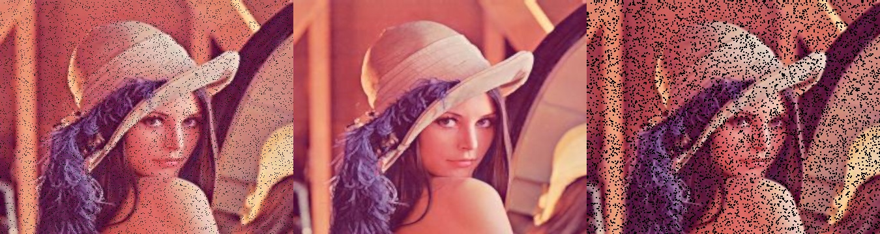

Image Filtering
Running Max/min Filters
Output example of a $3×3$ Max (middle) and a $3×3$ min filter (right) on an image corrupted by pepper noise (left).

